Slide 1

TMA3084 SOFTWARE ENGINEERING LABORATORY
Lesson 3
03
Dart Functions & Object-Oriented Programming
Lab Demo: MD. Aminul Islam Rakib
Lecturer: Madam Nurfauza Binti Jali
Created By: Mr. Raynold Anak Kabai

Slide 2
LESSON 3
What we will cover
01
Functions
Structure, return types, void, expression body, scope
02
Object-Oriented Programming
Object, class, methods, getters and setters, inheritance, abstract class
03
Dart Project Structure and Libraries
Project folders, pubspec.yaml, importing libraries
04
Null Safety in Dart
Nullable types, ?, !, late, required
05
Lab Exercise 2.1
Create a Small Overtime Payment Program
2

Slide 3
01 FUNCTIONS
Functions and Function Structure
A function is a named block of code that does one specific task or returns a value.
It stops us repeating code, so programs stay organised and easy to change.
Dart also ships built-in functions inside its libraries.
anatomy.dart
int add(int a, int b) {
return a + b;
}
int
add
Return type
Function name
(int a, int b)
{ ... }
Parameters
Function body
3

Slide 4
01 FUNCTIONS
Creating a Function
Defining a function is not enough. It only runs when main() calls it.
Defined but never called
Called inside main()
main.dart
main.dart
void printSomething() {
print('Hello Function!');
print('Welcome to Lab 3!');
}
void main() {
}
void printSomething() {
print('Hello Function!');
print('Welcome to Lab 3!');
}
void main() {
printSomething();
}
OUTPUT
(nothing is printed)
OUTPUT
Hello Function!
Welcome to Lab 3!
4

Slide 5
01 FUNCTIONS
Function Return String Data
The return type String is written before the function name.
return sends the text back to the place that called the function.
print() then displays the returned value.
main.dart
String courseName() {
return 'Flutter Application Development';
}
void main() {
print(courseName());
}
OUTPUT
Flutter Application Development
5

Slide 6
01 FUNCTIONS
Function Return int Data
Parameters x and y receive the values 3 and 5.
return z hands the sum back to the caller.
Without return, the result would never reach main().
main.dart
int sumCalculator(int x, int y) {
var z = x + y;
return z;
}
void main() {
var result = sumCalculator(3, 5);
print('Sum Result = $result');
}
OUTPUT
Sum Result = 8
6

Slide 7
01 FUNCTIONS
Function Return bool Data
A bool function returns only true or false.
Useful for checks such as age or login rules.
The if / else decides which value is returned.
main.dart
bool isAdult(int age) {
if (age >= 18) {
return true;
} else {
return false;
}
}
void main() {
print(isAdult(20));
print(isAdult(15));
}
OUTPUT
true
false
7

Slide 8
01 FUNCTIONS
Void Function
A void function does not return a value.
It performs a task, such as printing or changing data through its parameters.
Without a return type Dart assumes dynamic, so write void when nothing is returned.
main.dart
void greet(String name) {
print('Hello, $name');
}
void main() {
greet('Aina');
greet('Raynold');
}
OUTPUT
Hello, Aina
Hello, Raynold
8

Slide 9
01 FUNCTIONS
Function Returning Expression
Use the => (arrow) operator to return a value in a short way.
It works when the body is a single expression.
The result is the same as writing a full body with return.
main.dart
int multiply(int a, int b) => a * b;
String hello() => 'Hello Dart';
void main() {
print(multiply(4, 5));
print(hello());
}
OUTPUT
20
Hello Dart
9

Slide 10
01 FUNCTIONS
Functions and Variable Scope
Where a variable is declared decides where it can be used.
A global variable is visible to every function.
A local variable only lives inside its own function.
main.dart
String company = 'UNIMAS'; // global
void showInfo() {
String faculty = 'FCSIT'; // local
print('$company - $faculty');
}
void main() {
showInfo();
print(company);
// print(faculty); // error
}
OUTPUT
UNIMAS - FCSIT
UNIMAS
10

Slide 11
02 Object Oriented Programming (OOP)
Object and Class
Class
Object
A blueprint or template. It defines the properties (attributes) and behaviours (methods) of its objects.
An instance of a class. It holds real values for the attributes and can perform the behaviours the class defines.
Car
model, color, maxSpeed
perodua1
Bezza, Silver
perodua2
Axia, White
creates
11

Slide 12
02 Object Oriented Programming (OOP)
Creating a Class
Step 1: declare a class with the class keyword. Here it is called Car.
Step 2: add properties inside the class. Each property is a variable that belongs to Car.
late means the value is assigned after the object is created.
car.dart
// Step 1
class Car {
}
// Step 2
class Car {
late String model;
late String color;
late String maxSpeed;
late String numOfSeats;
}
12

Slide 13
02 Object Oriented Programming (OOP)
Creating an Object
Step 3: create an instance of the class. Car is the blueprint, perodua is the object.
Dot notation sets and reads each property.
Dart 3 lets you leave out the new keyword.
main.dart
class Car {
late String model;
late String color;
late String maxSpeed;
late String numOfSeats;
}
void main() {
var perodua = Car();
perodua.model = 'Bezza';
perodua.color = 'Silver';
perodua.maxSpeed = '120km/h';
perodua.numOfSeats = '5';
print('Car model name is ${perodua.model}');
}
OUTPUT
Car model name is Bezza
13

Slide 14
02 Object Oriented Programming (OOP)
Adding Methods to Classes
A method is a function that lives inside a class.
It describes what the object can do.
Call it with dot notation: object.method().
main.dart
class Car {
late String model;
late int maxSpeed;
void showInfo() {
print('$model, max $maxSpeed km/h');
}
void drive() => print('$model is driving');
}
void main() {
var myCar = Car();
myCar.model = 'Bezza';
myCar.maxSpeed = 120;
myCar.showInfo();
myCar.drive();
}
OUTPUT
Bezza, max 120 km/h
Bezza is driving
14

Slide 15
02 Object Oriented Programming (OOP)
Your Classes: Constructors
A constructor runs automatically when an object is created.
It has the same name as the class and no return type, not even void.
It sets the starting state of the object, so no more property-by-property assignment.
main.dart
class Car {
String model;
String color;
// constructor
Car(this.model, this.color);
}
void main() {
var perodua = Car('Axia', 'Silver');
print('Model name ${perodua.model}');
}
OUTPUT
Model name Axia
15

Slide 16
02 Object Oriented Programming (OOP)
Your Classes: Named Constructor
A named constructor gives an object a ready-made set of values.
Write ClassName.name() and fill in the properties after the colon.
Create the object with Car.axia().
main.dart
class Car {
String model;
String color;
Car.axia()
: model = 'Axia',
color = 'White';
}
void main() {
var perodua = Car.axia();
print(perodua.model);
}
OUTPUT
Axia
16

Slide 17
02 Object Oriented Programming (OOP)
Class Getters and Setters
A setter (set) assigns a value to a private variable.
A getter (get) reads the value back.
A name starting with _ is private to its library.
main.dart
class Car {
String _model = '';
set modelName(String name) => _model = name;
String get modelName => _model;
}
void main() {
var perodua = Car();
perodua.modelName = 'Bezza 2025';
print(perodua.modelName);
}
OUTPUT
Bezza 2025
17

Slide 18
02 Object Oriented Programming (OOP)
Class Inheritance
Inheritance lets a new class reuse an existing class (the parent or super class).
Use the extends keyword.
Teacher gets all properties of Student without rewriting them.
main.dart
class Student {
String name = '';
String email = '';
}
class Teacher extends Student {
void message() {
print('I am from Teacher class');
}
}
void main() {
var trainer = Teacher();
trainer.name = 'Aina';
trainer.message();
print(trainer.name);
}
OUTPUT
I am from Teacher class
Aina
18

Slide 19
02 Object Oriented Programming (OOP)
Abstract Class
An abstract class is a class that acts like a template or blueprint for other classes.
An abstract class tells other classes what they must do, but it does not always explain how to do it.
A class with at least one method that has no body is abstract.
It must carry the abstract keyword.
It cannot be instantiated. Its only purpose is to be inherited.
main.dart
abstract class Student {
void contactInfo(); // no body
}
void main() {
var s = Student();
// Error: abstract classes can't
// be instantiated
}
19

Slide 20
02 Object Oriented Programming (OOP)
Abstract Class: Child Class
The child class must implement every abstract method, marked @override.
An abstract class may also contain normal methods with a body.
Create objects from the child class, not the abstract parent.
main.dart
abstract class Student {
void contactInfo();
void courseInfo() => print('Course: TMA3084');
}
class ITStudent extends Student {
@override
void contactInfo() => print('Contact: it@unimas.my');
}
void main() {
var s = ITStudent();
s.contactInfo();
s.courseInfo();
}
OUTPUT
Contact: it@unimas.my
Course: TMA3084
20

Slide 21
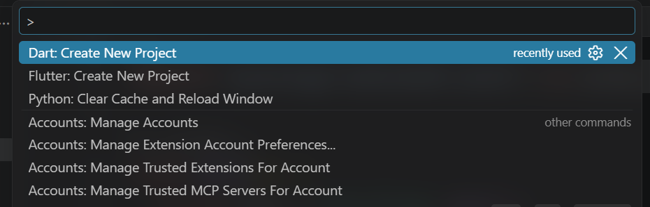
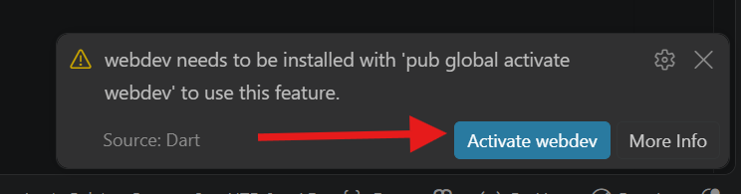
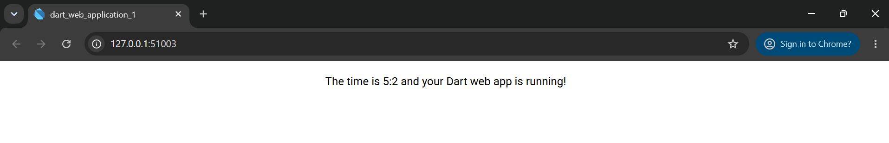
03 PROJECT STRUCTURE
Dart Project Setup
1
New project
In VS Code press Ctrl + Shift + P, then choose Dart: Create New Project.
Run the main.dart file and activate the webdev
Automatically open web browser
Video Tutorial: Click Here
21

Slide 22
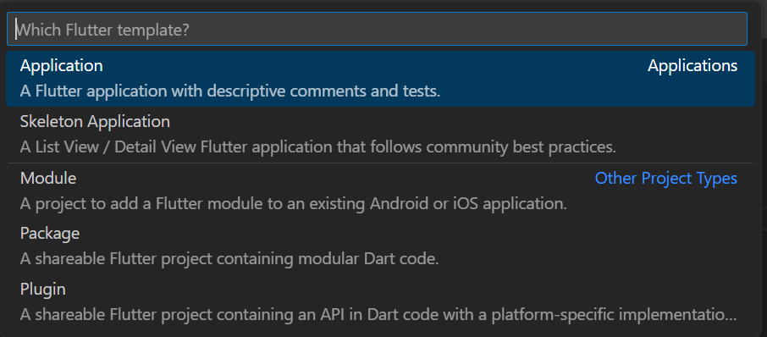
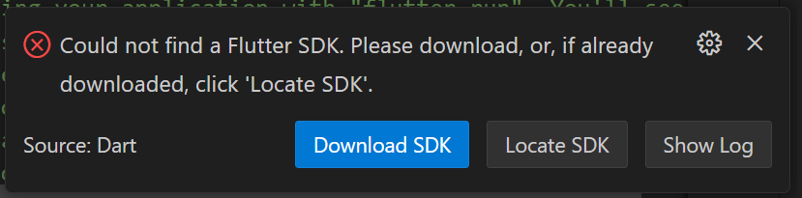
03 PROJECT STRUCTURE
Flutter Project Setup
1
New project
In VS Code press Ctrl + Shift + P, then choose Flutter: New Project.
2
SDK error
On first use VS Code reports that the Flutter SDK is missing. Git must be installed first. We already setup git in our first lab class.
21

Slide 23
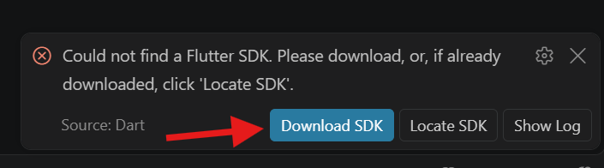
03 PROJECT STRUCTURE
Dart Project Setup
3
Get the SDK
We have two Options
  Option one Direct click Download SDK
  We can manually download from official website and install it.
Option 2:
Step 1: First time install the flutter sdk
Click here => https://docs.flutter.dev/install/manual
Step 2: Extract the zip file
21

Slide 24
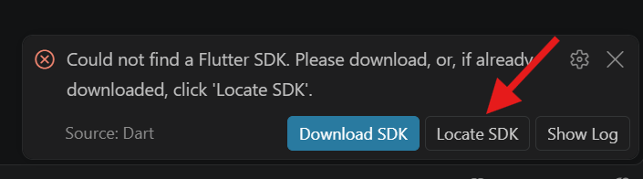
03 PROJECT STRUCTURE
Dart Project Setup
4
Locate SDK
In VS Code click Locate SDK and select the flutter\bin folder, then pick your folder and project name.
select this path: local_computer_disk: flutter_windows_flutter-version-stable\flutters\bin
21

Slide 25
03 PROJECT STRUCTURE
Dart Project Structure
lib
lib/
test
test/
yaml
pubspec.yaml
Holds your Dart library files and main code. Small projects may keep files at the root instead.
Holds testing files, where you write and organise unit tests.
Main configuration file: dependencies, environment settings, project name and version.
22

Slide 26
03 LIBRARIES
Dart Libraries and pubspec.yaml
List external libraries under dependencies in pubspec.yaml.
Run flutter pub get in the terminal to download them.
Built-in libraries use dart:, downloaded packages use package:.
pubspec.yaml
dependencies:
flutter:
sdk: flutter
http: ^1.2.0
main.dart
import 'dart:math';
import 'package:http/http.dart' as http;
void main() {
print(sqrt(16));
}
OUTPUT
4.0
23

Slide 27
04 NULL SAFETY
Null Safety: Nullable Types
By default a Dart variable can never hold null.
Add ? after the type to allow null.
Use ?. and ?? to handle null safely, and ! only when you are sure the value exists.
main.dart
void main() {
String name = 'Aina';
String? nickname; // nullable
print(nickname?.length);
print(nickname ?? 'No nickname');
nickname = 'Ain';
print(nickname!.length);
}
OUTPUT
null
No nickname
3
24

Slide 28
04 NULL SAFETY
Null Safety: late and required
late promises Dart the variable is assigned before it is read.
required forces the caller to supply a named parameter.
Both avoid null values without making the type nullable.
main.dart
late String token;
class Employee {
final String name;
final double salary;
Employee({required this.name,
required this.salary});
}
void main() {
token = 'abc123';
var e = Employee(name: 'Aina', salary: 3000);
print('${e.name} $token');
}
OUTPUT
Aina abc123
25

Slide 29
05 LAB EXERCISE 2.1
Overtime Payment: Setup and Library
Step 1: open VS Code, choose File > Open Folder, create a folder named Lab3 and open it.
Step 2: add a new file myLib.dart and define the Employee class.
myLib.dart
class Employee {
late String jobTitle;
late String location;
late double salary;
late double overtimeHr;
Employee(this.jobTitle, this.location,
this.salary, this.overtimeHr);
}
26

Slide 30
05 LAB EXERCISE 2.1
Overtime Payment: main.dart
Step 3: add main.dart in the Lab3 folder.
Import the library, create the employee, work out the overtime rate and print the total.
main.dart
import 'myLib.dart' as emp;
void main() {
double extraPayPerHr;
var william = emp.Employee(
'Manager', 'Madrid', 5000, 7);
if (william.salary >= 4000) {
extraPayPerHr = 10;
} else {
extraPayPerHr = 20;
}
double total = william.salary +
(william.overtimeHr * extraPayPerHr);
print('Total Salary = \$$total USD');
}
27

Slide 31
05 LAB EXERCISE 2.1
Overtime Payment: Run the Program
Step 4: in VS Code choose Terminal > New Terminal.
Type the command and press Enter.
Salary 5000 is at least 4000, so extra pay is 10 per hour: 5000 + (7 x 10).
Terminal
dart main.dart
OUTPUT
Total Salary = $5070.0 USD
28

Slide 32
?
Any Questions?
Lesson 3: Dart Functions & OOP

Slide 33
Thank you
Mr. Raynold Anak Kabai
Lab Demo, TMA3084 Software Engineering Laboratory

